Slide 1
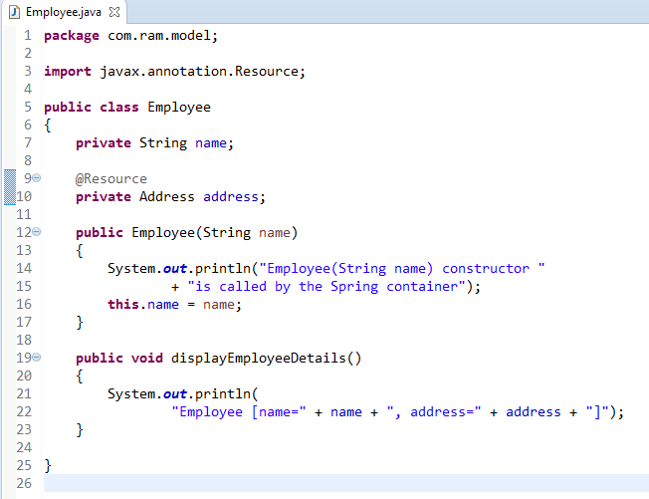
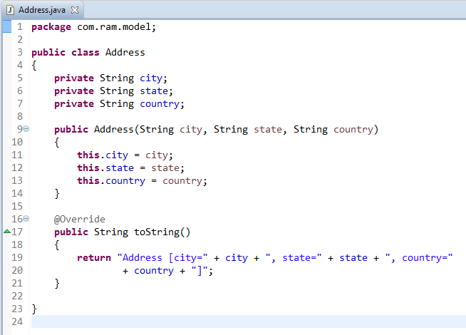
Spring Auto-Wiring Beans with @Resource annotation
The @Resource annotation is auto wire the bean by matching name.
We can use @Resource annotation to auto wire bean on the setter method, constructor or a field. Moreover, it can autowired property in a particular bean. Here we have applied @ Resource in field.
The @Resource annotation is part of the JSR-250 annotation collection and is packaged with Java EE.

Slide 2
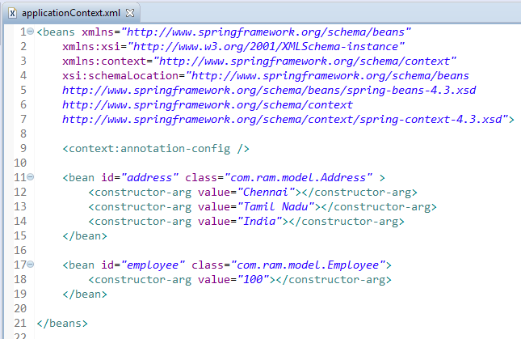
Spring Auto-Wiring Beans with @Resource annotation

Slide 3
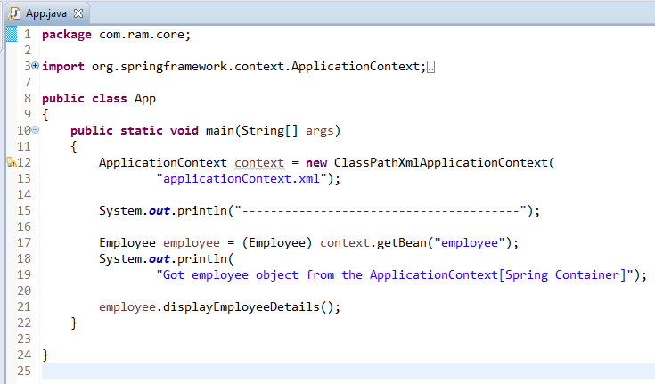
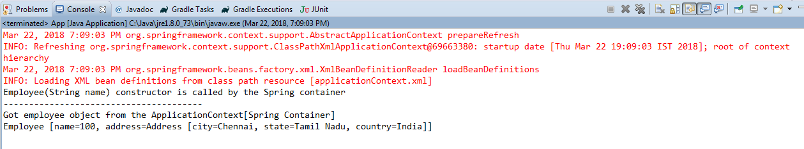
Spring Auto-Wiring Beans with @Resource annotation

